Slide 1
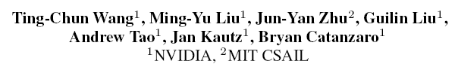
Video to Video Synthesis

Slide 2
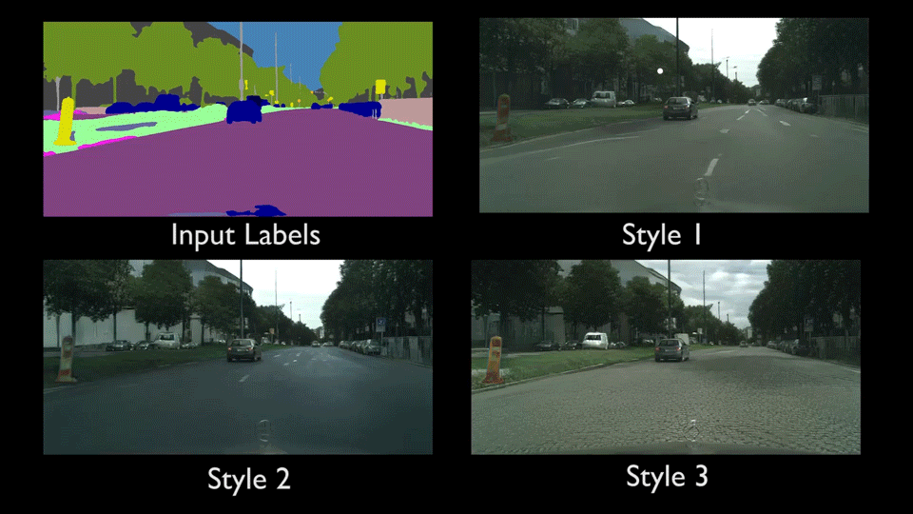
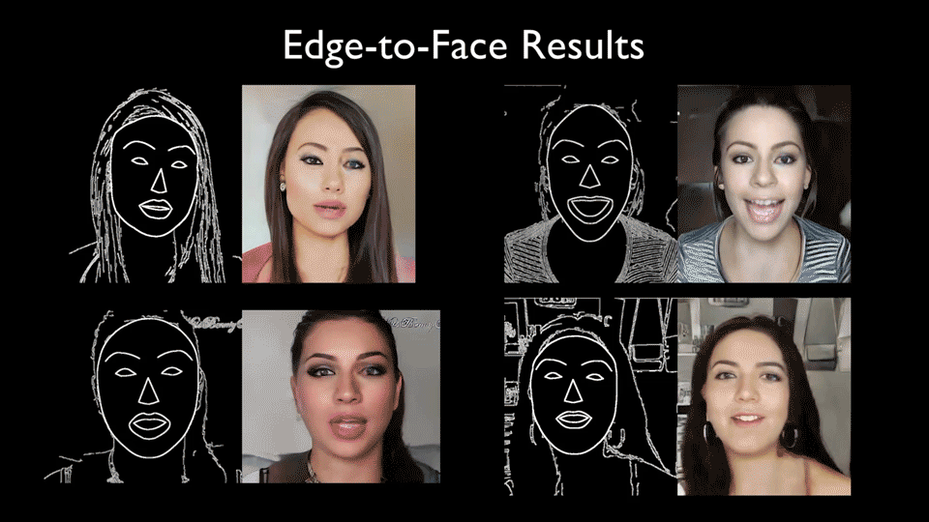
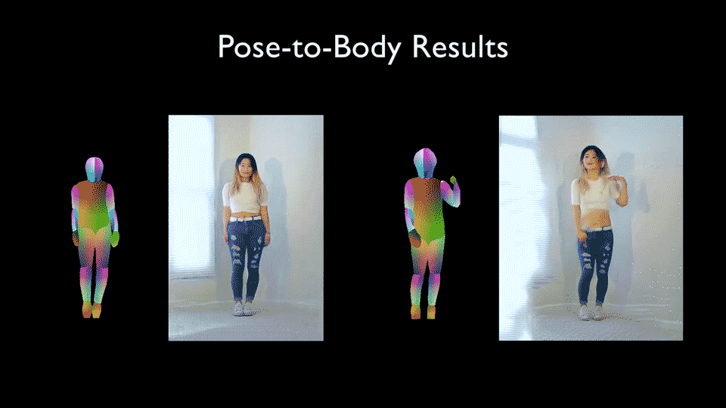

Slide 3
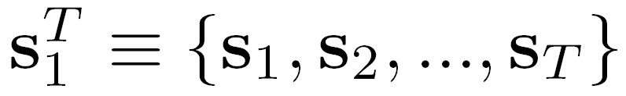
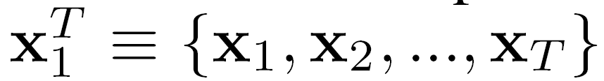
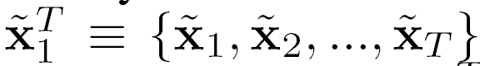
Problem Formulation
Source images for video synthesis
Corresponding real images
Generated images
Structure
Image Discriminator
Sequential Generator
Video Discriminator

Slide 4
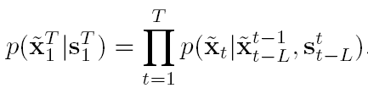
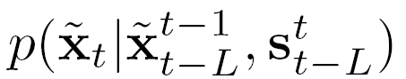
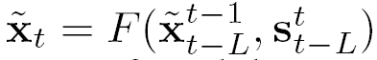
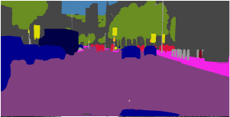
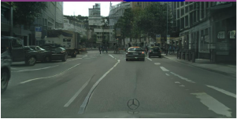
Sequential Generator
Markov assumption
S_{t-L}
S_{t-L+1}
S_{t}
…
…
x_{t-L}
x_{t-L+1}
Notes:
L=2 in practice

Slide 5
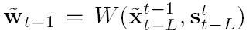
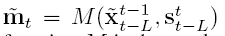
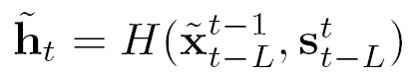
Sequential Generator
Estimated optical flow
Occlusion mask
Hallucinated image from scratch
S_{t-L}
S_{t-L+1}
S_{t}
…
…
x_{t-L}
x_{t-L+1}

Slide 6
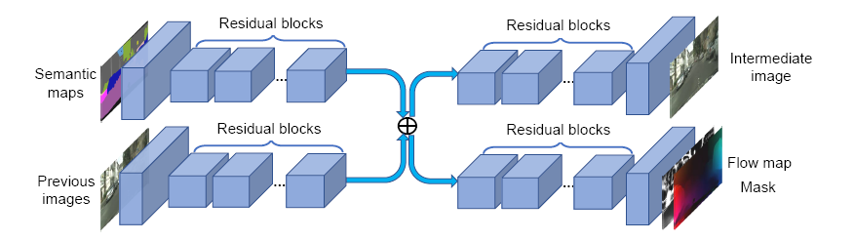
Sequential Generator
Detailed structure: based on pix2pixHD

Slide 7
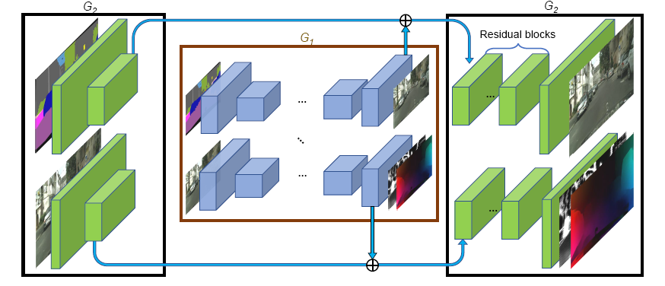
Sequential Generator
Detailed structure: based on pix2pixHD

Slide 8
Conditional Image Discriminator
Each output frame resembles a real image

Slide 9
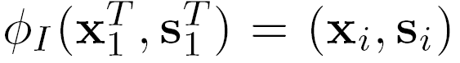
Conditional Image Discriminator
Each output frame resembles a real image
i : an integer uniformly sampled from 1 to T

Slide 10
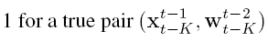
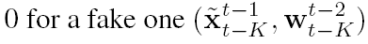
Conditional Video Discriminator
Consecutive output frames resemble the temporal dynamics of a real video

Slide 11
Conditional Video Discriminator
Consecutive output frames resemble the temporal dynamics of a real video
i : an integer uniformly sampled from K+1 to T+1

Slide 12
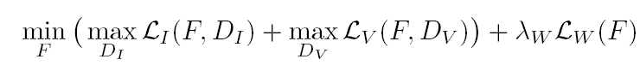
Learning Objective Function
Image Discriminator
Video Discriminator
Constrain to optical flow

Slide 13
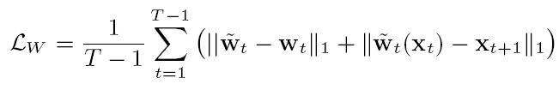
Learning Objective Function
Constrain to optical flow
Image Discriminator
Video Discriminator
Constrain to optical flow
Endpoint error
Warping loss

Slide 14
Other Points
Foreground-background prior:
Foreground: cars, pedestrian
Background: trees, road
Multimodal synthesis: one to many

Slide 15
Foreground-Background Prior
Estimated optical flow
Occlusion mask
Hallucinated image from scratch
S_{t-L}
S_{t-L+1}
S_{t}
…
…
x_{t-L}
x_{t-L+1}

Slide 16
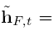
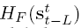
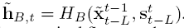
Foreground-Background Prior
Estimated optical flow
Occlusion mask
S_{t-L}
S_{t-L+1}
S_{t}
…
…
x_{t-L}
x_{t-L+1}

Slide 17
Foreground-Background Prior
Estimated optical flow
Occlusion mask
Ground truth background mask
S_{t-L}
S_{t-L+1}
S_{t}
…
…
x_{t-L}
x_{t-L+1}
Notes:
背景通常是整体变换，光流比较准确，通过光流能够有一个比较好的的初始结果
前景通常变换较大，光流较难估计，H_f需要从无到有的生成

Slide 18
Multimodal Synthesis
Training:
Encode the real image x_{t} into a 3D feature map
Instance feature averaging
(Pixels within the same object share the same feature vectors)
Feed s_{t} and z_{t} to F
Testing:
Fit GMM to z_{t}
Sample a z_{t} and send it to F

Slide 19
Experiments
Implementation details
Multiscale: 512 x 256, 1024 x 512, 2048 x 1024
40 Epochs with 8 V100
Training 10 days for 2K resolution
Datasets
Cityscapes: 2048 x 1024, 2975 videos (30 frames each)
Apolloscape: 73 scene videos (100~1000 frames each)
Face video dataset: 854 videos
Dance video dataset: 512 x 720, 3~4 mins

Slide 20
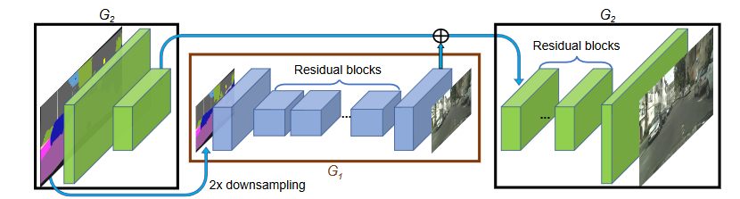
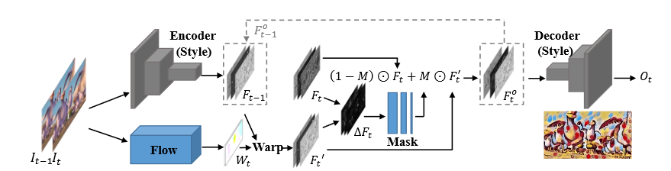
Experiments
Pix2pix HD (CVPR 2018): synthesis frame by frame
COVST (ICCV 2017)
Warp high-level deep features using optical flow
No adversarial learning is applied

Slide 21
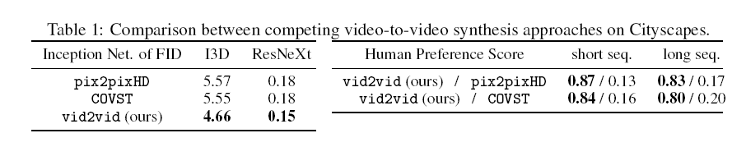
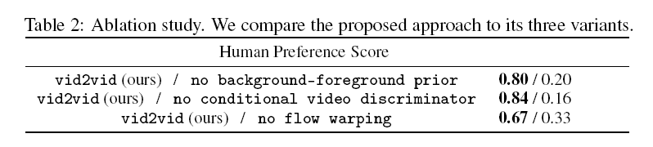
Evaluation
Inception Score & Human Preference Score
Ablation study

Slide 22
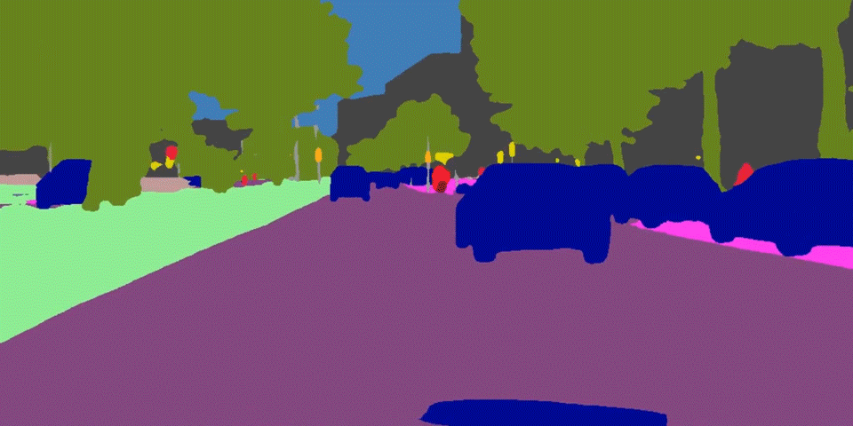
Main Results
Notes:
从paper里打开吧

